Slide 2
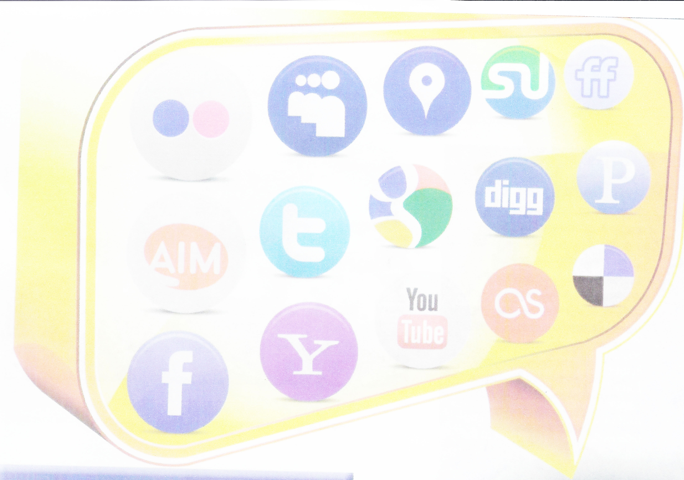
Ethics and Social Media
By Kim Beavers, Katie McCoy, and Stephanie Wise
August 2, 2012
Photo Credit – Kolus, . (2010).

Slide 3
Shift Happens Video
http://www.youtube.com/watch?v=XVQ1ULfQawk
Rose, D., Fisch, K., McLeod S., & Xplane (2012).

Slide 4

Table of Contents
History of Social Media
Social Media Resources
Ethical Behavior
Unethical Behavior
Cyber Bullying Training
Resources for Cyber Bullying
Social Media Benefits
Best Practices
Twitter
Facebook
Wiki/Blogs
Conclusion
References/Photo Credits
Photo Credit – The Tweet Tank (2010)

Slide 5
Poll – Use Social Media
Do you use social media?
Yes
No

Slide 6
Define Social Media Poll
How would you define social media?
Facebook
Xanga
Twitter
Any Internet site that allows people to interact online
Careless, J. (2012).
Notes:
Define Social Media or Use Social Media Poll – which question are we using to poll on this slide?
Kim running the poll – Katie talking about it

Slide 7

History of Social Media
What is social media?
Who began the process?
What is its basic function/purpose?
Curtis, D. A. (2011) Photo Credit – Top News (2012)
Notes:
Katie - Do Poll, Kim running the Poll Slide; then show next slide where Kim tells about examples of Social Media.
Go back to this slide when done.

Slide 8
Social Media
Facebook www.facebook.com
Twitter www.twitter.com
LinkedIn www.linkedin.com
Xanga www.xanga.com
MySpace www.myspace.com
YouTube www.utube.com
Skype www.skype.com
Yahoo www.yahoo.com
Flickr www.flickr.com
AIM www.aol.com
Notes:
Kim --Do question: how would you define Social Media, then show next slide where Kim tells about examples of Social Media.

Slide 9
Ethical Behavior
A system of moral principles.
What are ethics?
Why are ethics important with social media in education?
Hegna, J., & Johnson, D. (2010) Dictionary.com (2012)
Notes:
Stephanie or Katie?

Slide 10

Ethical Behavior
Be present in the ethics of technology!
Prepare students for their futures.
Equip students to engage with technology.
REFERENCES - Photo Credit – Forte, J. (2012, March 7)
Notes:
Stephanie

Slide 11
Ethical Behavior
Ethical factors to consider
Privacy issues for educators and students¹
Internet Safety²
Scams
Cyberbullying
Stealing
Appropriate Use³
Time Management
1. Timm, D. (2008) 2. isafe.org (2012) 3. Johnson, M. (2012)

Slide 12
Poll - How Aware/Equipped are You to deal with Ethical Issues in the classroom concerning Social Media?
How aware/equipped are you to deal with ethical issues in the classroom concerning Social Media?
I’m very aware/equipped
I’m somewhat aware/equipped
I’m not aware/equipped

Slide 13
Unethical Behavior
Cyber-bullying
Cyberstalking
Cyberharassment
Sexual Predators
“Therefore rid yourselves of all malice and all deceit, hypocrisy, envy, and slander of every kind.”
(1 Pet. 2:1)
Bible – NIV (2012). Photo Credit - Schroll, T. (2012, January 20).
Notes:
Stephanie

Slide 14
Cyberbullying Training
Identify cyber-bullying practices. ^{1, 2, 3, 4}
Develop clear policies.
Provide staff training.
Teach students online “Netiquette” and how to monitor their online reputation.
Notes:
Kim to talk about Cyber bullying reporting form and 50% of teachers do not feel adequately trained.

Slide 15
Resources for Cyber-bullying
BrainPop www.brainpop.com
Common Sense Media www.commonsensemedia.org/education
ConnectSafely www.connectsafely.org
Cyberbullyhelp www.cyberbullyhelp.com
Learning.com www.learning.com/parents
Stopbullying.gov www.stopbullying.gov
Web Wise Kids www.webwisekids.org
I-Safe www.i-safe.org
Scamex Scamex curriculum found in I-safe
Levy, P. (2011)
Notes:
Kim and Stephanie

Slide 16

Unethical Behavior
Cyber Stealing
Identity
Plagiarism
Bootlegging
“You shall not steal.” (Ex. 20:15)
Photo Credit - National Crime Prevention Council. (2012).
Notes:
Stephanie

Slide 17
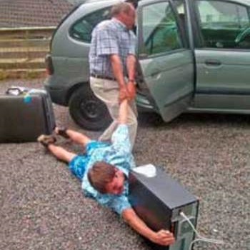
Unethical Behavior
Be a good
Steward of
Time & Technology
Providing Education or Temptation?

Slide 18
Biblical Principles
“So God created man in his own image, in the image of God he created him; male and female he created them.”
(Gen. 1:27, NIV)
“Do not withhold good from those who deserve it, when it is in your power to act.” (Prov. 3:27, NIV)
Bible NIV (2012)

Slide 19

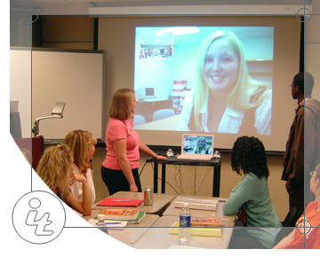
Social Media Benefits
INCREASED
CONNECTIVITY
EXTENDED
OPPORTUNITIES
Reference - Groothuis, (2012). Photo Credit -Great Journeys Discover the World (2010). Classroom – web URL is bad NEED INFORMATION
Notes:
Stephanie

Slide 20
Social Media Ideas
Twitter in the classroom ^{1, 2}
Teacher’s procedures for Facebook³
Resources:⁴
Glogster
SchoolTube, Inc.
Web2.0
Edublogs
SurveryMonkey
Notes:
Kim

Slide 21
Social Media Resources
Department of Education (US Government) www.cybersmart.com
Free Technology for Teacher http://www.freetech4teachers.com
Top 100 Tools for Learning http://c4lpt.co.uk/top-tools/top-100-tools-for-learning-2011/
21st Century Educational Technology and Learning http://21centuryedtech.wordpress.com
Shim, J., Dekleva, S., Guo, C., & Mittleman, D., (2011).
Notes:
Kim

Slide 22
Wiki/Blogs
Definition
Forums
Discussion
Incorporate wikis/blogs
Every student participates in blogging
Trust in the Lord with all your heart and do not lean on your own understanding. In all your ways, acknowledge Him, and he will make your paths straight (Proverbs 3:5-6).
Notes:
Kim

Slide 23
Conclusion
Social Media and Ethics Definitions
Ethical Implications of Social Media Use in the Classroom
Technology Training
Social Media Benefits and Disadvantages¹
Role/purpose of Social Media?
Notes:
See handout - the best practices and resources to help teachers get started in using Social Media in a classroom environment while stressing the ethical component of how to treat each other while in an on-line environment.
How to train students without the access or knowledge of the programs.

Slide 24
References
Agosto, D. E., Forte, A., & Magee, R. (2012). Cyberbullying and teens what YA librarians can do to help. Young Adult Library Services, 10(2), 38-43.
Ahn, J. (2011). Digital Divides and Social Network Sites: Which Students Participate in Social Media? Journal of Educational Computing Research, 45(2), 147-163. Retrieved on June 22, 2012.
Be CyberSmart!® cyber ethics and bullying - YouTube Retrieved 7/26/2012, 2012, from http://www.youtube.com/watch?v=WmjoDK0LZwI
Beer, D. (2008). Social network(ing) sites...revisiting the story so far: A response to danah boyd & nicole ellison. Journal of Computer-Mediated Communication, 13(2), 516-529. doi: 10.1111/j.1083-6101.2008.00408.x
Bennett, S., & Maton, K. (2010). Beyond the 'digital natives' debate: Towards a more nuanced understanding of students' technology experiences. Journal of Computer Assisted Learning, 26(5), 321-331. doi: 10.1111/j.1365-2729.2010.00360.x
Bible – NIV (2012).
Brown, A., & Slagter, v. T., (2010). Twenty-first century literacy: A matter of scale from micro to mega. Clearing House, 83(6), 235-238. doi: 10.1080/00098655.2010.484438
Careless, J. (2012, February 1) Social Media It Does Have a Place in the Classroom. TechLearning.com v32(7). P. 42-47
Curtis, D. A. (2011). The brief history of social media. North Carolina: University of North Carolina at Pembroke.
Cyberbullying research center - cyber bullying examples, cases, laws, articles, stories, presentations, videos, facts, statistics Retrieved 7/26/2012, 2012, from http://www.cyberbullying.us/research.php

Slide 25
References (continued)
Davis, M. R. (2012). N.Y.C. utlines social-media guidelines for educators. Education Week, 31(30), 11-11.
Denton, D. (2012). Enhancing instruction through constructivism, cooperative learning, and cloud computing. TechTrends: Linking Research & Practice to Improve Learning, 56(4), 34-41. doi: 10.1007/s11528-012-0585-1
Doer, B., Mahmoud, F., & Friedrich, T. (2012). Why Rumors Spread So Quickly in Social Networks. Communications of the ACM, 55(6), 70-75.
Dokoupil, T. (2012, ). Is the onslaught making us crazy? Newsweek, pp. 26.The article
Ethics. (n.d.). (2012) The Free On-line Dictionary of Computing. Retrieved from Dictionary.com website: http://dictionary.reference.com/browse/ethics
Goldsborough, R. (2008). Dealing with E-mail scams
Grossman, L. (2010). 2010 Person of the Year Mark Zuckerberg. (Cover story). Time, 176(26), 44-75.
Groothuis, D.Understanding social media | CRI Retrieved 8/2/2012, 2012, from http://www.equip.org/articles/understanding-social-media/
Hegna, J., & Johnson, D. (2010). Guidelines for educators using social and educational networking sites. Library Media Connection, 28(5), 50-51.
Holotescu, C., & Grosseck, G. (2012). M3-learning - exploring mobile multimedia microblogging learning. World Journal on Educational Technology, 4(1), 168-176.
Husa, V. (2012). Development of ICT competences in the environmental studies subject in Slovenia. World Journal on Educational Technology, 4(1), 190-198.

Slide 26
References (continued)
I-Educator Times. (2010). , 2--8.
Johnson, M. (2012). Teen talk: Social Media Issues. Providence, Rhode Island:
Junco, R. R., Heiberger, G. G., & Loken, E. E. (2011). The effect of Twitter on college student engagement and grades. Journal Of Computer Assisted Learning, 27(2), 119-132. doi:10.1111/j.1365-2729.2010.00387.x
Kidwai, S., & Imperatore, C. (2011). Social Media as an Advocacy Tool.
Techniques: Connecting Education & Careers, 86(6), 36-39.
Kolus, K. (2010). Let's Talk About Social Media: What's Your Message?. Long-Term Living: For The Continuing Care Professional, 59(10), 24-30.
Levy, P. (2011) Confronting Cyberbullying. The Journal, Volume 38, (5), 25-27. Retrieved on June 22, 2012.
Lewis, K., Kaufman, J., & Christakis, N. (2008). The Taste for Privacy: An analysis of college student privacy settings in an online social network. Journal of Computer-Mediated Communication, 14(1), 79-100. doi: 10.1111/j.1083-6101.2008.01432.x

Slide 27
References (continued)
Madhava, R. (2011). 10 Things to Know About Preserving Social Media. Information Management Journal, 45(5), 33-37.
Marcoux, E. (2012). Leadership & technology. Teacher Librarian, 39(5), 74-74.
Marcus, S. (2009). New basics for new literacies. Journal of the American Society for Information Science & Technology, 60(9), 1933-1938. doi: 10.1002/asi.21135
Mueller, W. (2007). Digital kids initiative. Retrieved, 2007, from http://www.cpyu.org/page.aspx?id=667657
Myspace. (2012). Retrieved 07/27, 2012, from http://en.wikipedia.org/wiki/Myspace
Pollet, T. V., Roberts, S. G. B., & Dunbar, R. I. M. (2011). Use of Social Network Sites and Instant Messaging Does not Lead to Increased Offline Social Network Size, or to Emotionally Closer Relationships With Offline Network Members. CyberPsychology, Behavior & Social Networking, 14(4), 253-258. doi: 10.1089/cyber.2010.0161
Poore, M. (2011). Digital literacy: Human Flourishing and Collective Intelligence in a Knowledge Society. Australian Journal of Language & Literacy, 34(2), 20-26.
Protecting Youths from Online Harassment: Cyberbullying and Sexting are Among the Risks to be Aware of. (2011). Harvard Mental Health Letter, 28(3), 4-4.

Slide 28
References (continued)
Rivero, V. (2011). We're Talking Social Media in Education. Internet@Schools, 18(3), 12-15.
Rose, D. S., Fisch, K., McLeod, S., & Xplane (2012). Shift Happens 2012. U-Tube Retrieved July 15, 2012 from http://www.youtube.com/watch?v=XVQ1ULfQawk
Shim, J., Dekleva, S., Guo, C. Mittleman, D., (2011). Twitter, Google, iPhone/iPad, and Facebook (TGIF) and Smart Technology Environments: How Well Do Educators Communicate with Students via TGIF?. Communications of AIS, 2011(29), 657-672.
Sprankle, B. (2009). T&L bloggers take on hackers and scammers. Technology & Learning, 29(7), 42-42.
Social media and distance education - DE oracle (2012). Retrieved from http://deoracle.org/online-pedagogy/emerging-technologies/social-media-and-distance-education.html
Teacher cadet technology: (2012, January)Retrieved from http://teachercadettechnology .blogspot.com/2012_01_01_archive.html
Teen internet use pew research center (2012). Retrieved from http://pewresearch.org/millennials/teen-internet-use-graphic.php
Teens and social media: An overview pew research center's internet & American Life Project (2012). Retrieved from http://www.pewinternet.org/Presentations/2009/17-Teens-and-Social-Media-An-Overview.aspx
Teens' excessive use of texting, social media linked to risky behavior. (2010). Annals of the American Psychotherapy Association, 13(4), 8-8.
Troutner, J. (2012). Cool Tools, Social Media, and Curriculum. Teacher Librarian, 39(4), 48-50.
Timm, D. M., & Duven, C. J. (2008). Privacy and Social Networking Sites. New Directions for Student Services, 2008(124), 89-101. doi:10.1002/ss.29
Twitter. (2012). Twitter Definition. Retrieved from http://en.wikipedia.org/w/index.php ?title=Twitter&oldid=504559786

Slide 29
References (continued)
Understanding social media CRI. (2012). Retrieved From http://www.equip.org/articles/understanding-social-media/
Walker, C. M., Sockman, B. R., & Koehn, S. (2011). An exploratory study of cyberbullying with undergraduate university students. TechTrends: Linking Research & Practice to Improve Learning, 55(2), 31-38. doi: 10.1007/s11528-011-0481-0
Walsh, M. (2010). Multimodal literacy: What does it mean for classroom practice? Australian Journal of Language & Literacy, 33(3), 211-239.
Weingarten, K., & Frost, C. (2011). Authoring wikis: Rethinking authorship through digital collaboration. Radical Teacher, (90), 47-57.
Whitehouse, G. (2010). Newsgathering and Privacy: Expanding Ethics Codes to Reflect Change in the Digital Media Age. Journal of Mass Media Ethics, 25(4), 310-327. doi:10.1080/08900523.2010.512827
When sharing goes too far. (2010), Consumer Reports, p 1.

Slide 30
Photo References
Dorsey, J. (2012) Jack Dorsey Twitter Page. Jack Dorsey Photo Retrieved from www.twitter.com/Jack
Duran (2011, April 11) Cyber World is Not Safe. Retrieved from http://blog.optimum7.com/duran/internet-usage/cyber-world-is-not-safe.html ;
Fleury-Lawson, (2010, November 30) Cyber Ethics and Cyber Bullying: Ethics and Technology Use in Education. Retrieved from http://ethicsandtechnologyuseineducation.blogspot.com/2010/11/cyber-ethics-and-cyber-bullying.html;
Forte, J. (2012, March 7) Two Easy Ways to Make Webinars More Personal. Teacher and Students at Computer Retrieved from http://www.mindflash.com/blog/2012/03/two-easy-ways-to-make-training-webinars-more-personal/
Globe and Mail Inc. (2011, March 20) The History of Twitter, 140 Characters at a Time. Globe and Email Photo Retrieved from http://www.theglobeandmail.com/technology/digital-culture/social-web/the-history-of-twitter-140-characters-at-a-time/article573416
Great Journeys Discover the World (2010). Globe Photo Retrieved from http://www.maps2anywhere.com/ globes/inflatable_world_globe.htm
Kolus, K. (2010). Let's talk about social media: What's your message?. Long-Term Living: For The Continuing Care Professional, 59(10), 24-30.
Microsoft Clipart (2012) Question and Answer from Clipart.

Slide 31
Photo References (continued)
National Crime Prevention Council. (2012). Take a Bite Out of Cyber Crime (bytecrime.org). Crime Stopper Photo Retrieved from http://www.ncpc.org/resources/enhancement-assets/logos-ncpc/byte-crime-org-logo.gif/view
Schroll, T. (2012, January 20). How to Create a Blog (like this one.) Teacher Cadet Technology Teacher Blog-Spot Retrieved from http://teachercadettechnology.blogspot. com/2012_01_01_archive.html
Stone, B. (2011, October 1) Behold, The Financial Superentity. Biz Stone Home Page. Retrieved from www.bizstone.com
The Tweet Tank (2010). The Tweet Tank. Twitter Logos Retrieved from http://www.thetweettank.com/?hop=creditbook
Top News. (2012). Facebook Team hits the road to promote IPO. Facebook Logos Retrieved from http://www.topnews.in/people/mark-zuckerberg
Top News. (2012). Facebook preparing for IPO. Mark Zuckerberg Photo Retrieved from http://www.topnews.in/people/mark-zuckerberg
Williams, E., (2012) Evan Williams Twitter Page. Photo retrieved from www.twitter.com/ev
Classroom Photo: Retrieved from http://it.mercer.edu/student/academic_technology/index.html
Car Photo Picture Reference
Twitter Screen Shot Reference

Slide 32

Question and Answers?

